Slide 1
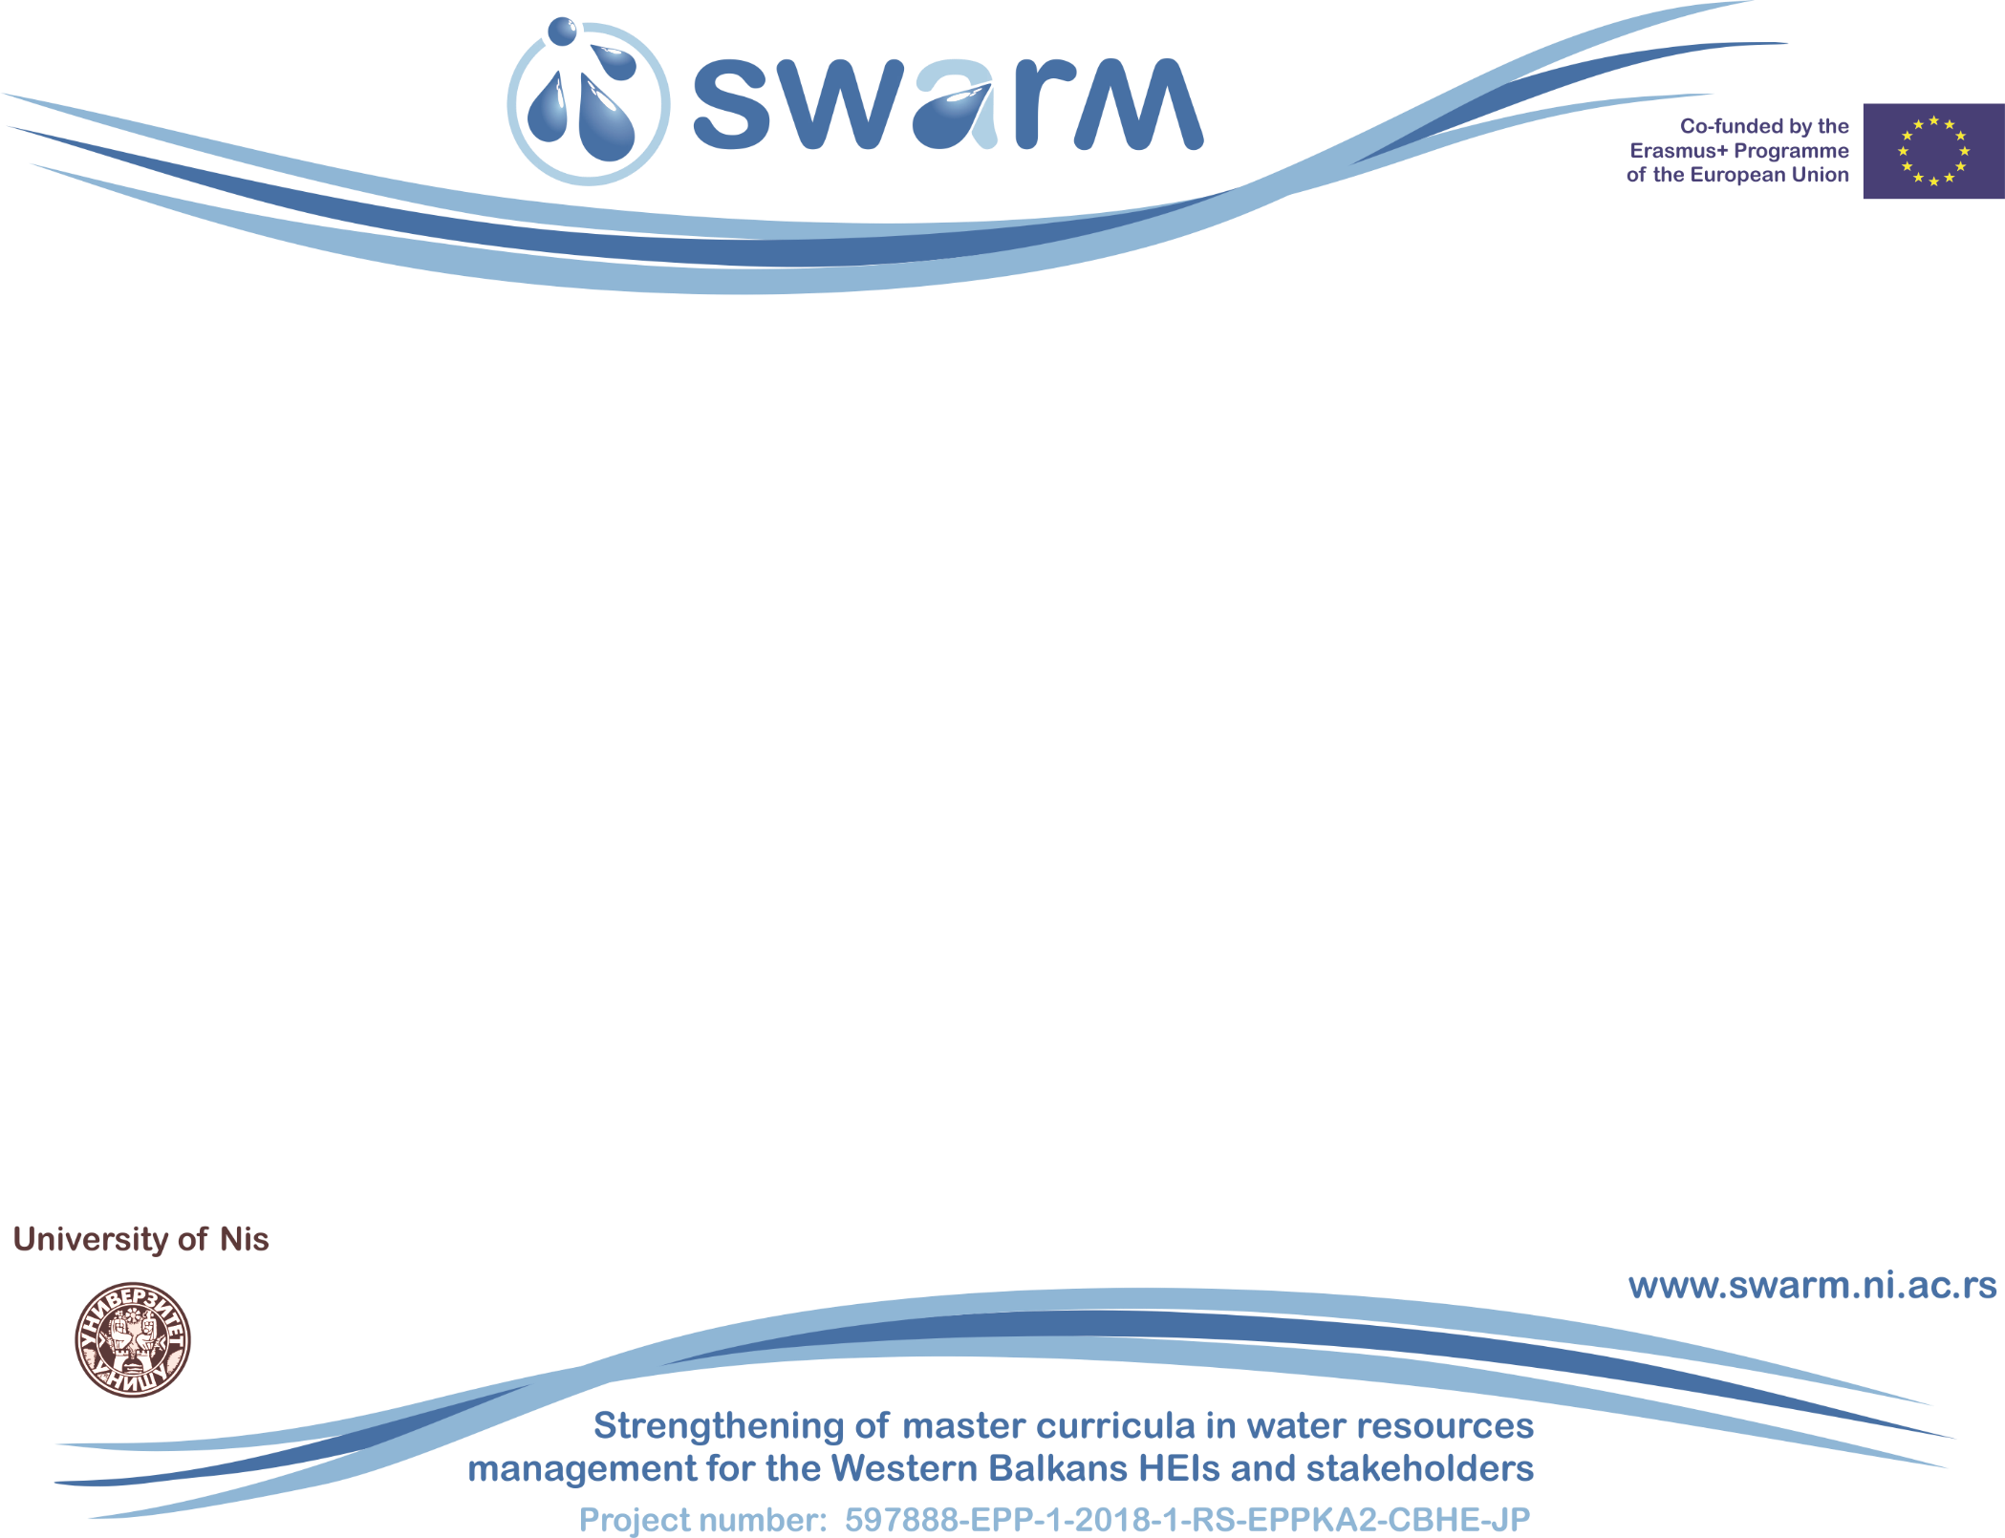
Innovative practices for WRM in Greece
Skoulikaris Haris
Aristotle University of Thessaloniki
Workshop on innovative practices in the EU water sector: barriers and opportunities / Vienna, 8-10 May 2019
This project has been funded with support from the European Commission. This publication reflects the views only of the author, and the Commission cannot be held responsible for any use which may be made of the information contained therein.

Slide 2
The Special Secretariat for Water (SSW), belonging to the Ministry of Environment and Energy, http://www.ypeka.gr/, is the authority, responsible for the development and implementation of all programs related to the protection and management of the water resources of Greece.
Implementation of EU Water Policy in Greece
More specifically the Secretariat is responsible, among others, for:
the implementation of the Water Framework Directive
the implementation of the national monitoring program
the implementation of the Nitrates Directive
the implementation of the Floods Directive
the implementation of the Urban Wastewater Directive and reuse programs
Transboundary and international water issues
Strengthening of master curricula in water resources management
for the Western Balkans HEIs and stakeholders
www.swarm.ni.ac.rs

Slide 3
The harmonization of the Greek legislation with the Water Framework Directive 2000/60/EC was made by the Law 3199/2003 (Government Gazette 280 A/09.12.2003) and the Presidential Decree 51/2007 (Government Gazette 54 / A / 08.03.2007).
Water Framework Directive
The provisions of the above national legislation incorporate the basic concepts of the EU Water Directive and, at the same time, the new administrative structure is established, as well as the competences of the individual bodies, both at national and regional level.
The River Basins and the Water Districts have been determined by the Decision No. 706 of the National Water Committee of 16.07.2010.
Strengthening of master curricula in water resources management
for the Western Balkans HEIs and stakeholders
www.swarm.ni.ac.rs

Slide 4
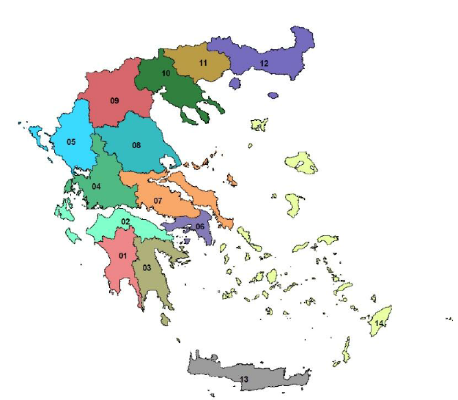
Water Districts in Greece
WD 01: WESTERN PELOPONNESE
WD 02: NORTHERN PELOPONNESE
WD 03: EASTERN PELOPONNESE
WD 04: WESTERN STEREA HELLAS
WD 05: HEPEIROS
WD 06: ATTICA
WD 07: EAST STEREA HELLAS
WD 08: THESSALY
WD 09: WESTERN MACEDONIA
WD 10: CENTRAL MACEDONIA
WD 11: EASTERN MACEDONIA
WD 12: THRACE
WD 13: CRETE
WD 14: AEGEAN ISLANDS
Strengthening of master curricula in water resources management
for the Western Balkans HEIs and stakeholders
www.swarm.ni.ac.rs

Slide 5
In each of the 14 Water Districts, National Water Management Plans, namely River Basin Management Plans (RBMPs), were developed for every single one of them.
The implementation of the WFD includes the following main components:
1. Assessment of the current situation
2. Organization of environmental objectives
3. Preparation of Monitoring Programs
4. Gap analysis
5. Establishment of the Program of Measures
6. Development of National Management Plans
7. Implementation of Program of Measures
8. Evaluation of the Program of Measures
9. Consultation with the public, active involvement of stakeholders
WFD implementation process
Strengthening of master curricula in water resources management
for the Western Balkans HEIs and stakeholders
www.swarm.ni.ac.rs

Slide 6
The first National Management Plans were approved by the Decision of the National Water Committee (Decision No. 1067, Government Gazette 182 / B / 31.1.2014). Public and interested authorities were requested to submit within 6 months any comments on the available documents of the 1st Update of River Basin Management Plans.
The Revised River Basin Management Plans concern the 2nd Management Cycle (2015-2021) of the Framework Directive and were adopted on 29 December 2017 (Government Gazette B 4680, B 4679, B 4672, B 4673, B 4675, B 4682, B 4664, B 4674, B 4665, B 4678, B 4681, B 4676, B 4666, B 4677) by the National Water Committee by decision of its President, Deputy Minister of the Environment.
WFD implementation process
Strengthening of master curricula in water resources management
for the Western Balkans HEIs and stakeholders
www.swarm.ni.ac.rs

Slide 7
The 2nd RBMPs include:
(a) Update of the identification and characterization of surface (river, lake, transitional and coastal) and groundwater bodies.
(b) Review and update reference conditions and the assessment and classification of surface, including highly modified and artificial, groundwater bodies, based on the new data available from the operation of the National Water Monitoring Network. c) Re-evaluation of surface systems with significant hydromorphological modifications (particularly modified (ITT) and artificial (TWS) water systems). d) Updating the list of significant pressures on water resources and their impacts.
WFD implementation process
Strengthening of master curricula in water resources management
for the Western Balkans HEIs and stakeholders
www.swarm.ni.ac.rs

Slide 8
The 2nd RBMPs include:
(e) Updating the Register of Protected Areas.
(f) Review of environmental objectives for all water bodies. g) Assessment of the progress of implementation of the original River Basin Management Plans of the country.
(h) Revision of the Basic and Supplementary Measures.
(i) Updating the economic analysis of water uses.
(j) Recording the transnational agreements up to now in transnational catchment areas.
WFD implementation process
Strengthening of master curricula in water resources management
for the Western Balkans HEIs and stakeholders
www.swarm.ni.ac.rs

Slide 9
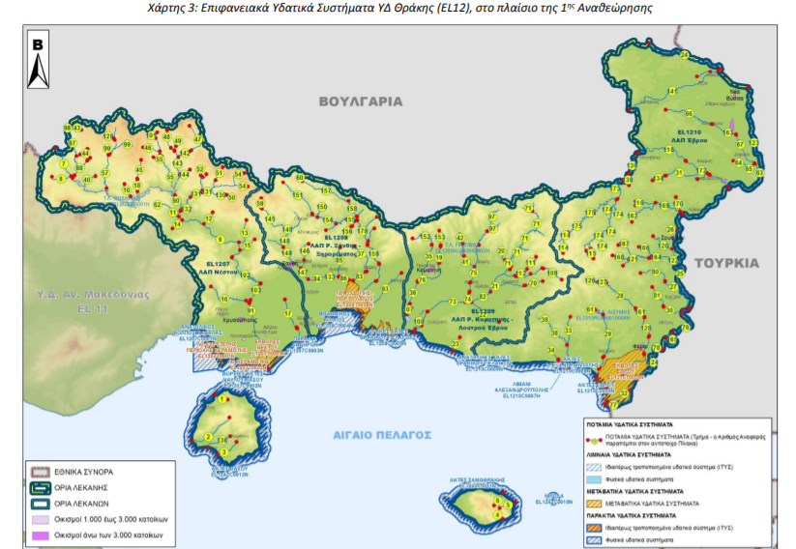
Strengthening of master curricula in water resources management
for the Western Balkans HEIs and stakeholders
www.swarm.ni.ac.rs

Slide 10
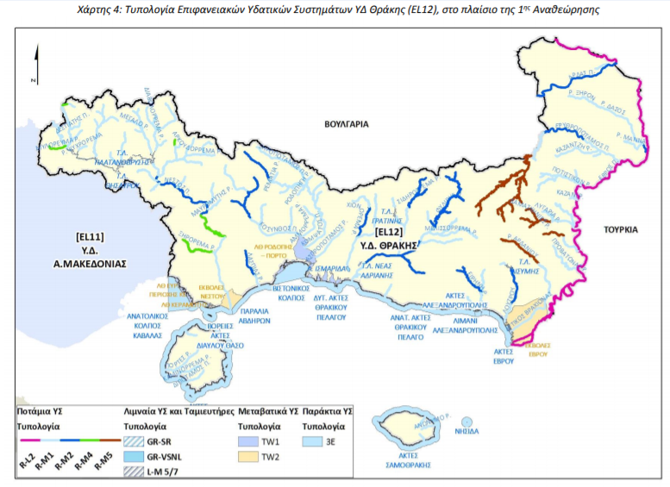
Strengthening of master curricula in water resources management
for the Western Balkans HEIs and stakeholders
www.swarm.ni.ac.rs

Slide 11
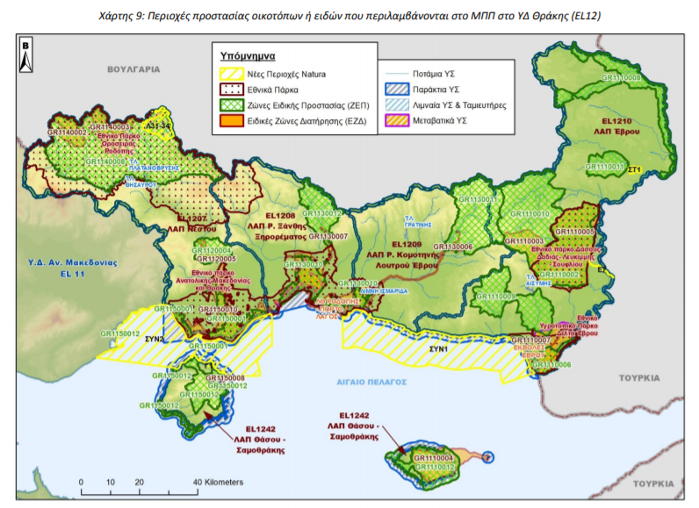
Strengthening of master curricula in water resources management
for the Western Balkans HEIs and stakeholders
www.swarm.ni.ac.rs

Slide 12
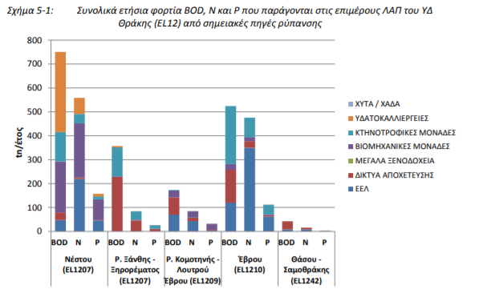
Strengthening of master curricula in water resources management
for the Western Balkans HEIs and stakeholders
www.swarm.ni.ac.rs

Slide 13
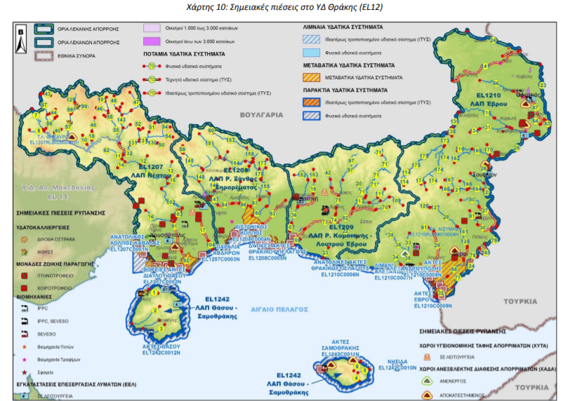
Strengthening of master curricula in water resources management
for the Western Balkans HEIs and stakeholders
www.swarm.ni.ac.rs

Slide 14
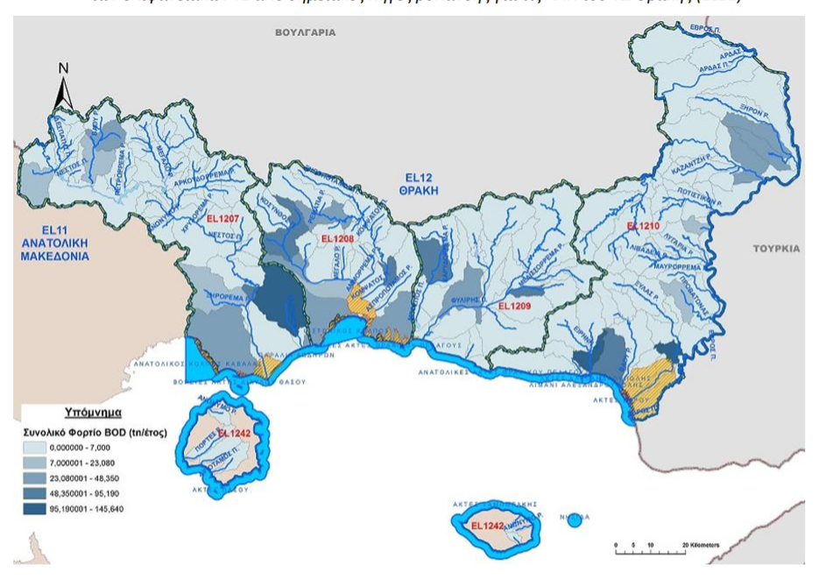
Strengthening of master curricula in water resources management
for the Western Balkans HEIs and stakeholders
www.swarm.ni.ac.rs

Slide 15
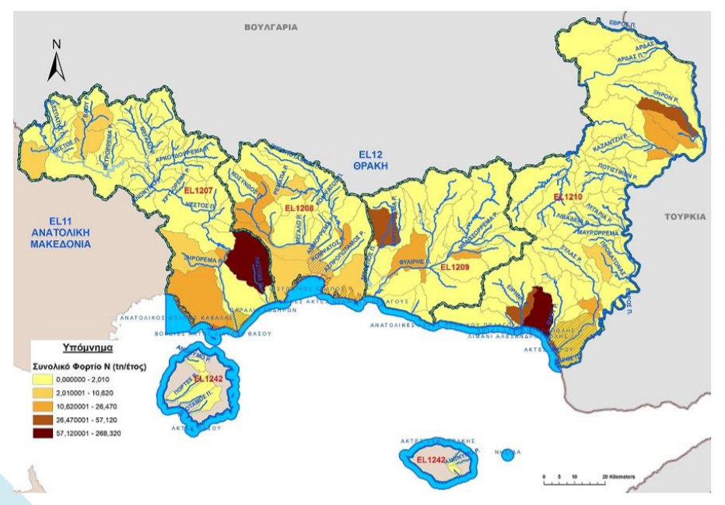
Strengthening of master curricula in water resources management
for the Western Balkans HEIs and stakeholders
www.swarm.ni.ac.rs

Slide 16
In line with the provisions of the WFD, Greece has established and recently revised a national monitoring program for the assessment of the status of surface water and ground water, in order to obtain a coherent and comprehensive overview of water status within each river basin district.
The National Water and Quality Monitoring Network of the country was completed through the adoption of the Joint Ministerial Decision on September 9, 2011 (Government Gazette 2017 B 09.09.2011)
The National Μonitoring Network comprises 449 survaillence and monitoring stations in rivers, 53 stations in lakes, 34 in transitional waters, 80 stations in coastal waters and 1,392 stations in groundwaters.
The total number of stations is 2008, from which 616 refer to surface waters and 1,392 to groundwaters).
National water monitoring
Strengthening of master curricula in water resources management
for the Western Balkans HEIs and stakeholders
www.swarm.ni.ac.rs

Slide 17
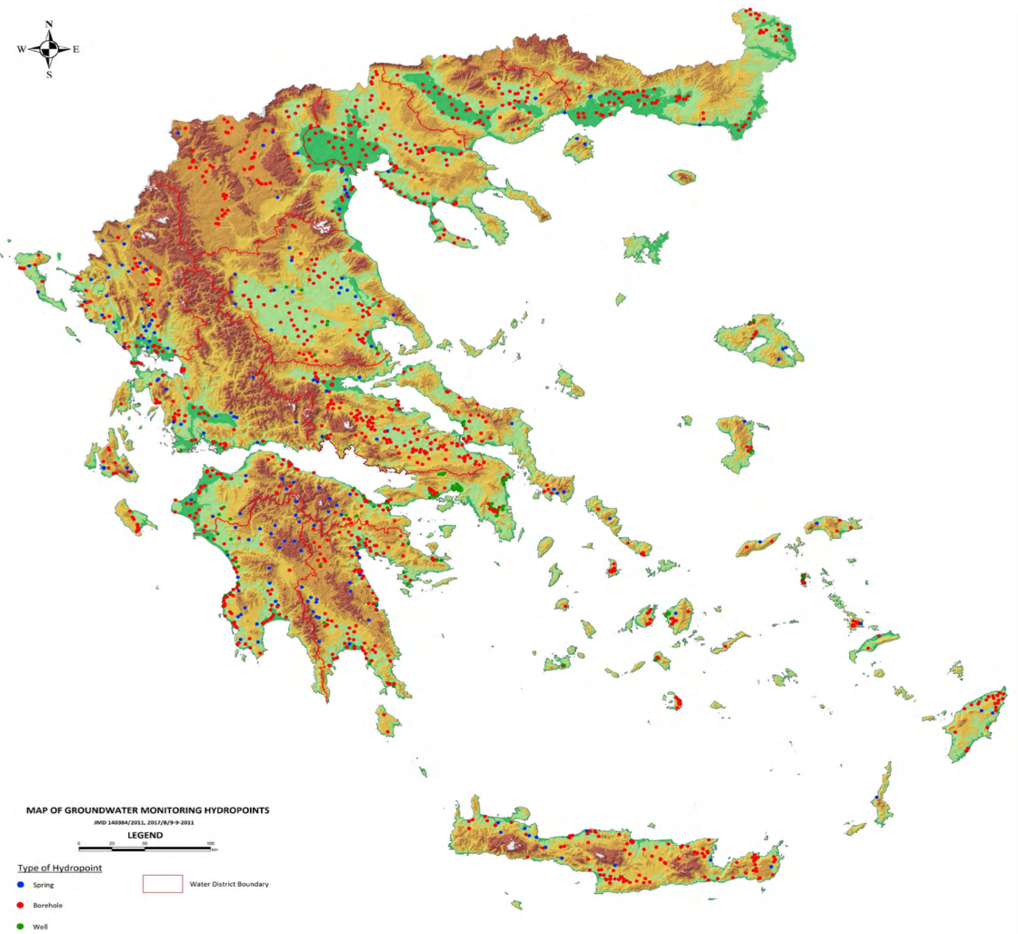
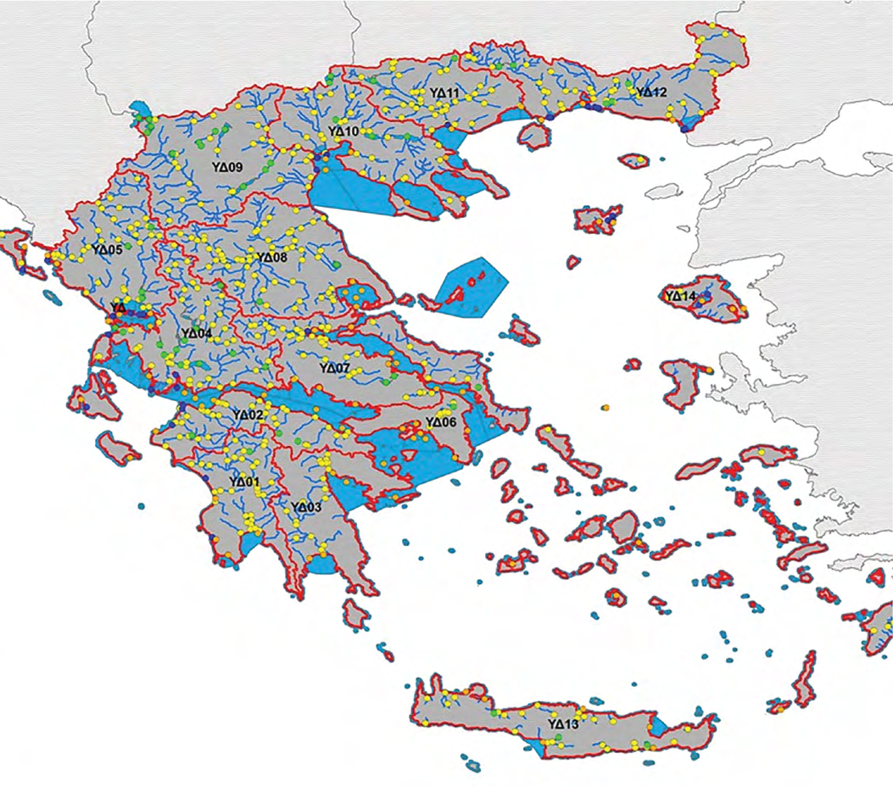
National water monitoring
Monitoring Network stations of surface water
Monitoring Network stations of groundwater resources
Strengthening of master curricula in water resources management
for the Western Balkans HEIs and stakeholders
www.swarm.ni.ac.rs

Slide 18
The data and information obtained are stored in electronic data bases, including the National Data Bank of Hydrological and Meteorological Information and the National Environmental Information Network and processed for reporting, and dissemination purposes.
National water monitoring
http://nmwn.ypeka.gr/
Strengthening of master curricula in water resources management
for the Western Balkans HEIs and stakeholders
www.swarm.ni.ac.rs

Slide 19
The Directive 2007/60/EC is carried out in coordination with the Water Framework Directive, notably by flood risk management plans and river basin management plans being coordinated, and through coordination of the public participation procedures in the preparation of these plans.
All assessments, maps and plans is made available to the public.
The Κ.Υ.Α. Η.Π. 31822/1542/Ε103/2010 (ΦΕΚ 1108 Β΄/2010) is the Joint Ministerial Decision which incorporated into the national law the Community Directive 2007/60 / EC of the European Parliament and of the Council of 23 October 2007 on "Evaluation and Managing Flood Risks ".
Flood Directive
Strengthening of master curricula in water resources management
for the Western Balkans HEIs and stakeholders
www.swarm.ni.ac.rs

Slide 20
In the context of the flood risk management plans, a special methodology for flood risk assessement was developed and applied in all River Basin Districts.
The aim is the evaluation of flood risk within the flooded areas as they came out from the hydraulic analysis performed for different return periods (Τ50, Τ100 και Τ1000), taking into consideration the flood hazard (depths, flow rate) and the vulnerability (based on potential impacts) of uses and activities in the flooded areas.
Flood Directive
Strengthening of master curricula in water resources management
for the Western Balkans HEIs and stakeholders
www.swarm.ni.ac.rs

Slide 21
Taking into consideration the provisions of the Directive 2007/60/ΕC and the relevant guidelines, the following General Targets were determined at a national level during the 1st cycle of implementation of the Directive 2007/60/ΕC:
For the achievement of the General Targets, there is a Program of Measures in the Flood Risk Management Plans for each River Basin District that covers all management aspects.
Flood Directive
Moderation of the exposure to flood
Reduction of the possibility of flood
Enhancement of preparedness for flood response
Improvement of restoration mechanisms for the affected areas
Strengthening of master curricula in water resources management
for the Western Balkans HEIs and stakeholders
www.swarm.ni.ac.rs

Slide 22
Agriculture is, on an EU level, the largest single source of nitrate (runoff, leaching) pollution, although households and industries also contribute to some extent.
As a consequence, the nitrate pollution problem is addressed within the European Union mainly by the Nitrates Directive (91/676/EEC), regarding nitrate pollution caused by agricultural practices, supplemented by the provisions of the Urban Wastewaters Directive (91/271/EC), related to sensitive recipients and the Groundwater Directive (2006/118/EC).
An important provision of the Nitrates Directive is the obligation of Member States to report every 4 years on the monitoring results of ground and surface water quality. Furthermore, Member States are compelled to designate so-called Nitrate Vulnerable Zones (NVZs).
Nitrates Directive
Strengthening of master curricula in water resources management
for the Western Balkans HEIs and stakeholders
www.swarm.ni.ac.rs

Slide 23
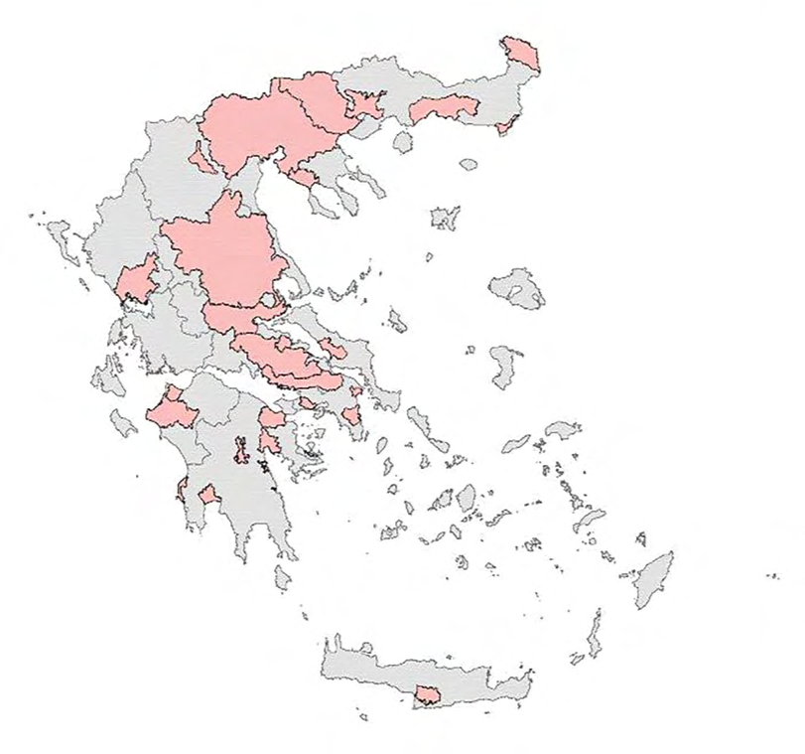
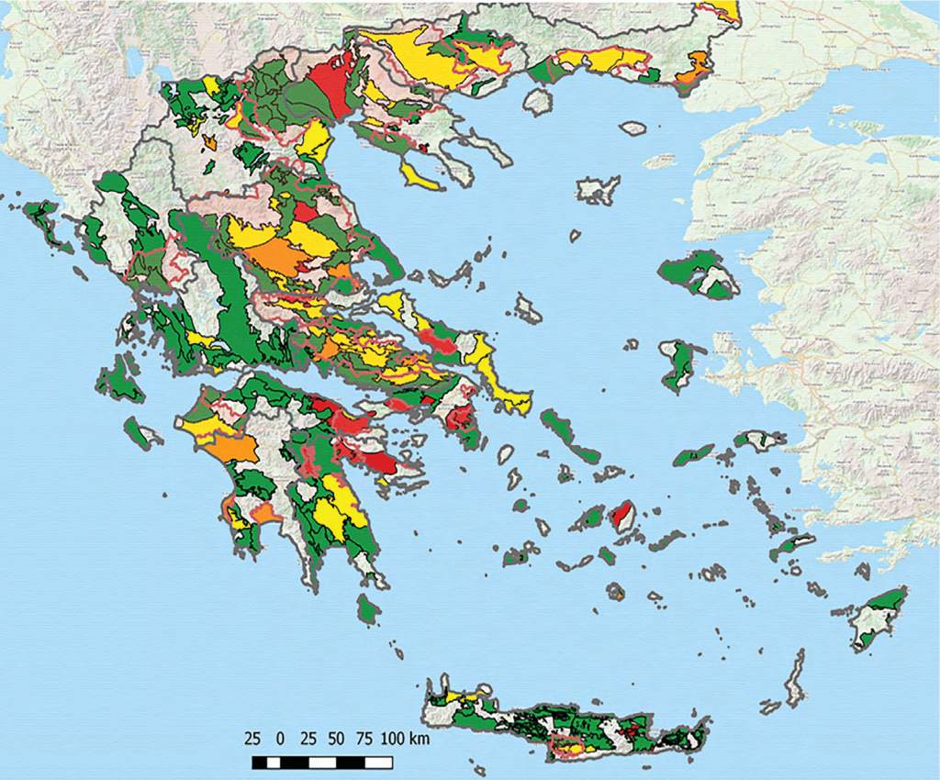
Nitrates Directive
Vulnerable Zones to pollution caused by nitrates from agricultural sources (pink color)
Distribution of the average over-concentration of nitrates per ground water system for the year 2012-2015
Strengthening of master curricula in water resources management
for the Western Balkans HEIs and stakeholders
www.swarm.ni.ac.rs

Slide 24
In Greece about 25% of surface waters in the form of lakes and rivers are transboundary waters which extend or come from our neighboring countries Turkey, Bulgaria, North Macedonia and Albania.
The UNECE Water Convention constitutes the overarching legal and institutional framework of transboundary water cooperation in the European Union.
The WFD refers to transboundary river basin management denoting that if both countries are Members of EC they should develop a common management plan along the whole water basin whereas if the transboundary water basin is shared between EU and non EU countries they can develop separate management plans according to their respective legislation.
Transboundary water management
Strengthening of master curricula in water resources management
for the Western Balkans HEIs and stakeholders
www.swarm.ni.ac.rs

Slide 25
February 2010: Agreement between Greece, Albania and the North Macedonia , with the participation of the European Union on the protection and sustainable development of the Prespa Park area.
May 2010: a "Joint Declaration on the protection of the river Evros" was signed between Greece and Turkey,
July 2010: Joint Declaration "on understanding and cooperation in the field of use of water resources in the respective territories of the Common RBDs shared by the Republic of Bulgaria and the Hellenic Republic", which provides for the coordination of actions for the preparation of Management Plans of transboundary river basin, in line with the WFD.
Transboundary water management
Strengthening of master curricula in water resources management
for the Western Balkans HEIs and stakeholders
www.swarm.ni.ac.rs

Slide 26
River basins and basin agreements in the European Union can be found at: http://ec.europa.eu/environment/water/water-framework/facts_figures/pdf/Transboundary-cooperation- %202012.pdf (Source: European Commission)
Transboundary water management
Strengthening of master curricula in water resources management
for the Western Balkans HEIs and stakeholders
www.swarm.ni.ac.rs

Slide 27
Ευχαριστώ!
Strengthening of master curricula in water resources management
for the Western Balkans HEIs and stakeholders
www.swarm.ni.ac.rs

